Slide 1
Eiwitstructuren
Lehninger (6e) Hfd. 4
Campbell (10e) Hfd. 5.4

Slide 2
Onderwerpen Ch. 4 Lehninger.
Non-covalent interactions.
Secundaire structuur: α helix, β strand (en β structuren) en β turns.
Motieven (super secundaire structuur).
Domeinen.
Tertiaire structuur.
Quaternaire structuur.
Denatureren.
8. Oplosbaarheid van eiwitten.

Slide 3
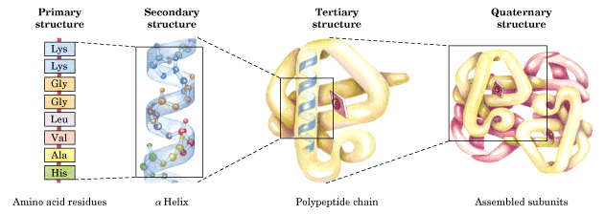
Structuurnivo’s van een eiwit (i.c. hemoglobine)
(Lehn. fig 3.16)
aminozuur- secundaire en tertiaire structuur komen tot stand volgorde dankzij hydrofobe interacties, H-bruggen, ionogene i.a. en disulfide bonds
covalent bonds

Slide 4
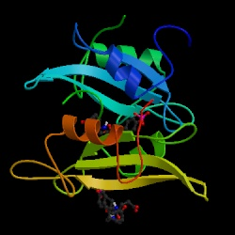
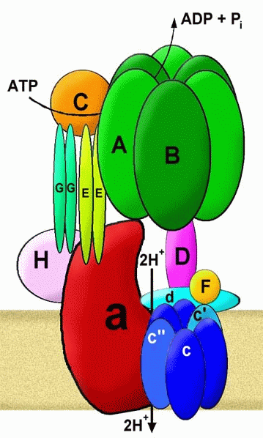
Protein Structures
Primary structure: Amino acids form chains, the sequence
Secondary structure: α-helices, β-strands, β-turns, and loops
Tertiary stucture: secondary structure elements fold further to make whole proteins
Quaternary structure: Proteins or protein-subunits combine to produce a functional unit
Protein kinase
ATPase

Slide 5
Protein Structure and Function
The specific activities of proteins result from their intricate three-dimensional architecture
A functional protein consists of one or more polypeptides precisely twisted, folded, and coiled into a unique shape

Slide 6
Figure 5.16
Target
molecule
Groove
Groove
(a) A ribbon model
(b) A space-filling model
(c) A wireframe model
Notes:
Figure 5.16 Structure of a protein, the enzyme lysozyme

Slide 7
Primaire structuur
Unieke sequentie van aminozuren
Peptidebindingen
N-terminus (aminogroep)
C-terminus (carboxylgroep)

Slide 8
Figure 5.15
Notes:
Figure 5.15 Making a polypeptide chain

Slide 9
Figure 5.UN01
Amino acids
Notes:
Figure 5.UN01 In-text figure, amino acid monomer, p. 75

Slide 10
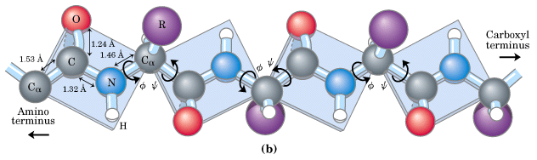
Rotational freedom only about the N-Cα and Cα-C bond: phi (φ) en psi (ψ) are the bond angles.
The six atoms of the peptide group lie in a single plane. The C_{α} ‘s are the HINGES for the planes.
(L. fig 4.2)

Slide 11
Welk aminozuur zorgt voor een bocht?

Slide 12
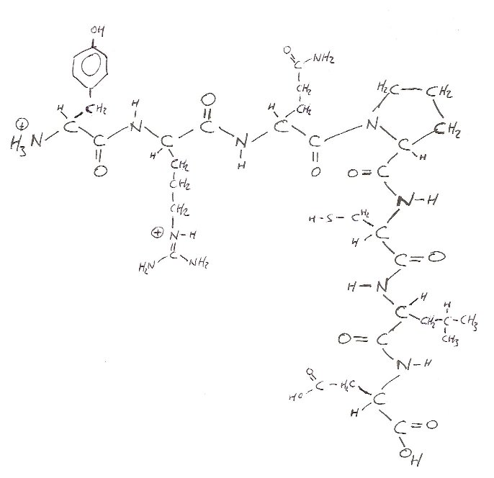
Primary structure of a peptide; Proline gives a bend in the peptide chain. Proline has a high preference for β turns (secondary structure). Proline is abundant in the polyproline helix of collagen.
NH₃⁺ on the left
COOH on the right
effect of proline; N in a 5 ring; secondary amino group (= imino group)

Slide 13
Secundaire structuur
Verbindingen tussen basisketen
Waterstofbruggen tussen H en O
Alleen vanuit amino- en carboxylgroep
Verschillende manieren van vouwing

Slide 14
SECONDARY STRUCTURE (Campb. fig 5.21)
helix (right handed)
β−pleated sheet, β−conformation or β-structure
β−turns and loops

Slide 15
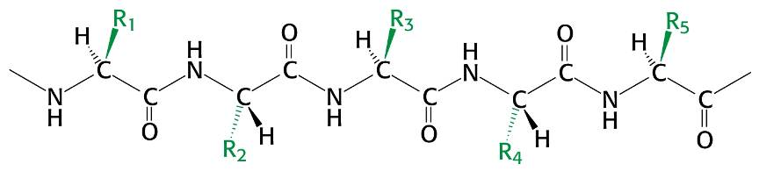
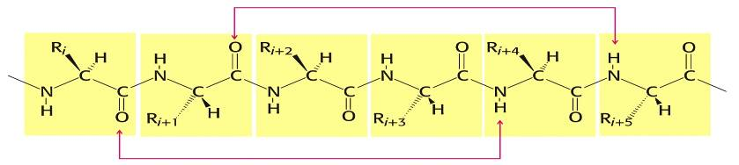
Geometric most real look; primary structure, the peptide strand is in its most stretched structure, like in β strands. H-bonds formed in an α helix (Str fig 3.30)
Notes:
15
15
15

Slide 16
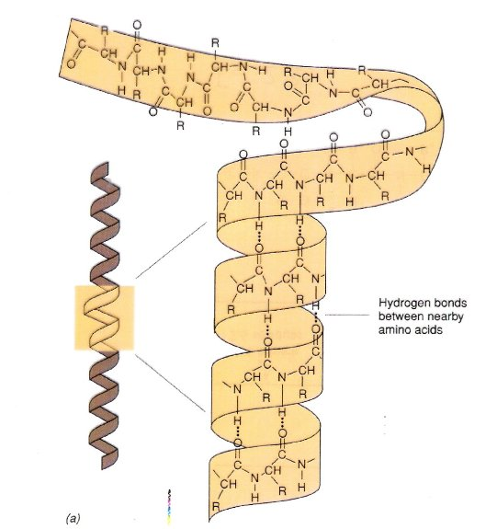
secondary structure; the α helix (other secondary structures are β conformations and β turns) (Brock fig 3.13)
Stabilized by H-bonds between C = O and H – N of the peptide backbone 4 residues up or downstream
The rise in one turn is 5.4 A; in one turn are 3.6 residues → rise per residue is 1.5 A

Slide 17
Welke aminozuren zijn (bijna) niet te vinden in een a-helix?

Slide 18
Proline:
Ring is niet buigzaam en
kan geen waterstofbruggen vormen!
Glycine:
Te flexible waardoor het teveel energie kost om glycine sterk te houden

Slide 19
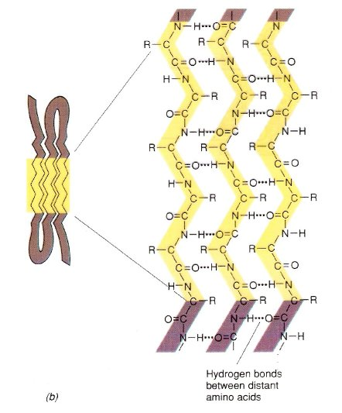
Secondary structure; β-sheet, β-conformation or β-structure. Arises when 2 or more β strands are arranged side by side. β-structures are stabilized by H-bonds of the peptide backbone. The peptide chain in a β strand is in its most stretched form, the length (rise) per residue is 3.5 A. (Brock fig 3.16)
b-structure

Slide 20
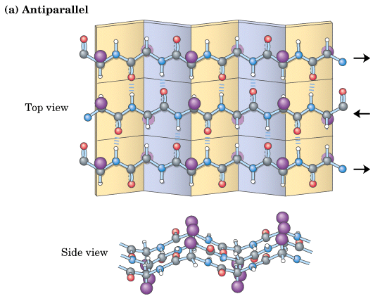
β-sheet or β-conformation: H-bonds between antiparallel “β-strands”. R-goups are extending out from the β-sheet alternating on both sites of the sheets. (Lehn. fig 4-7)

Slide 21
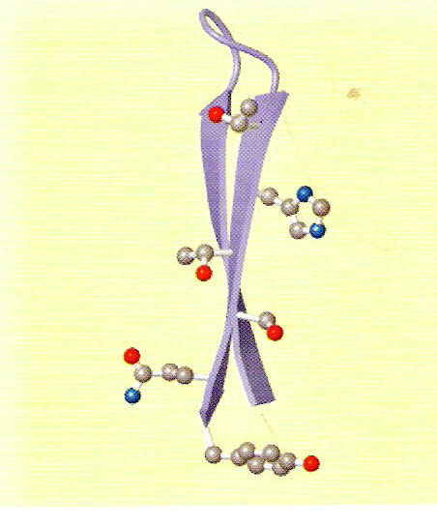
2 β-strands and a β-turn; the two β strands form a β structure. The strands are twisted. Only the restgroups in the front strand are indicated. (Horton fig 4.16)

Slide 22
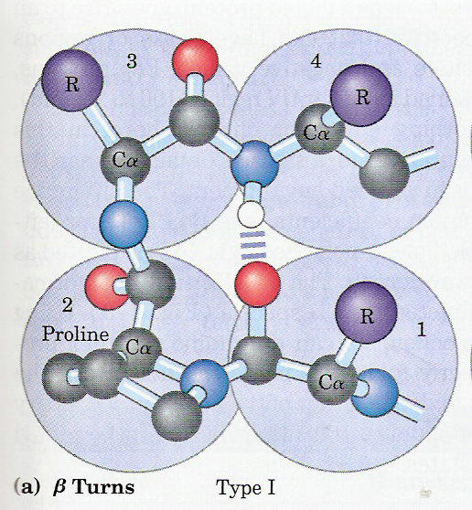
In proteins about 1/3 of the residues is in β turns and loops. β turns link, in particular, successive runs of β strands. gly and pro are abundant in β turns. β turns consist of 4 amino acid residues; a H-bond is formed between C=O of amino acid 1 and N-H of amino acid 4. (Lehn fig 4-8)

Slide 23
All structure levels; this is figure 5.21 (8e) in Campbell.

Slide 24
About 2/3 of the residues resides in a β structure or α helix. The average length of an α helix is 12 (from 5 to 40) residues. The average length of a β strand is 6 residues. A typical β sheet contains from 2 to 15 β strands. (Lehn table 4-2)

Slide 25
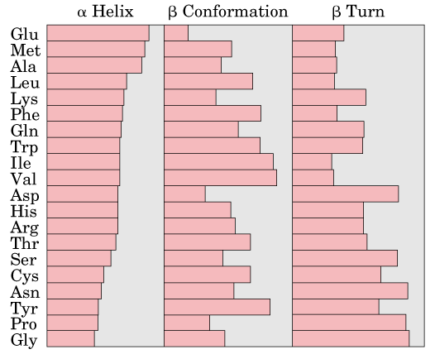
Relative probabilities that a given amino acid will occur in the three common types of secondary structure. (val loves strand and hates turn !) (Lehn fig 4-10)

Slide 26
1. What is meant with the “rise per residue” ?
How large is the rise in a α helix and in a β strand ?
Which structure is more compact (= condensed) ?
2. Which interaction is determining (stabilising) the secundary structure ?
3. Draw two β strands of each 5 residues in an antiparallel
β sheet.

Slide 27
Motieven
(super secundaire structuur)(fold)
A recognizable folding pattern involving two or more elements of secondary structure and the connection between them.

Slide 28
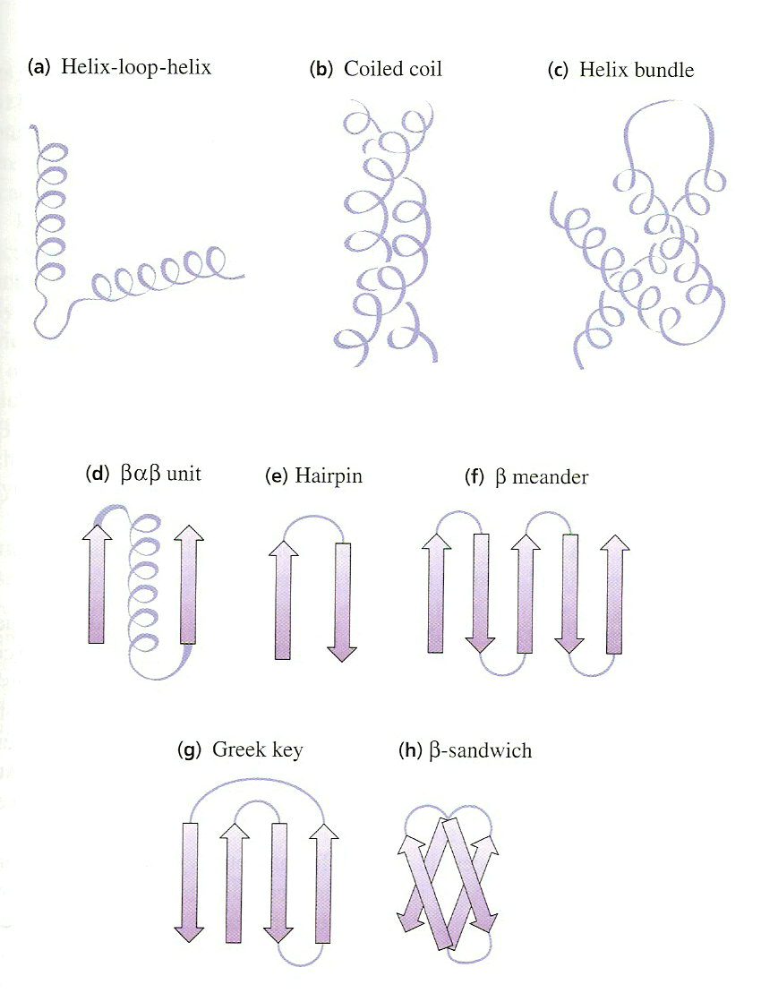
MOTIFS or super secondary structures are combinations of α helices, β-strands and loops that are more often seen. (Horton fig 4.19)

Slide 29
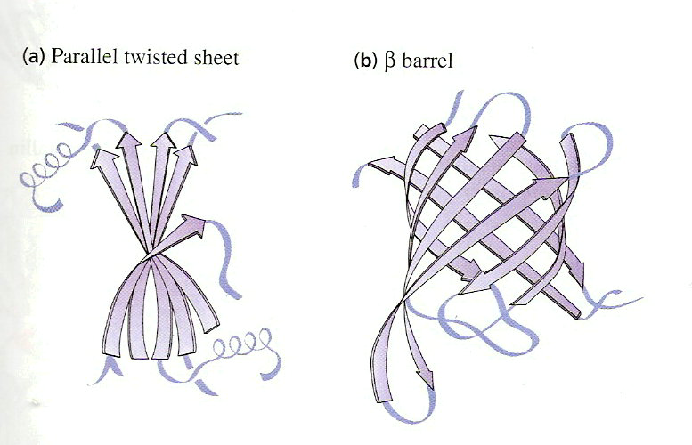
In most proteins the β strands are twisted and the β sheets are distorted and buckled → other β structures → MOTIFS (all β). (Horton fig 4.23)
Motieven (super secundaire structuur).

Slide 30
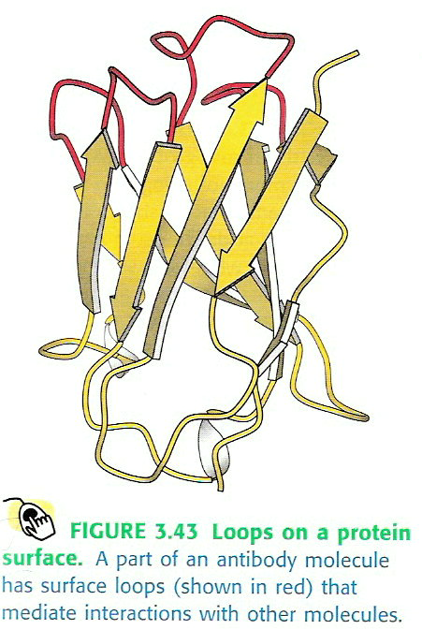
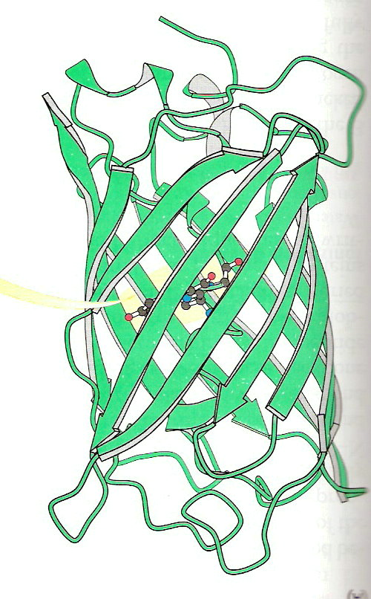
β−strands forming β-structures. These β-structures are also β-motifs. These motifs can also be domains. (Loops do not have a regular, periodic structure ) (Str fig 3.43 and 3.60)

Slide 31
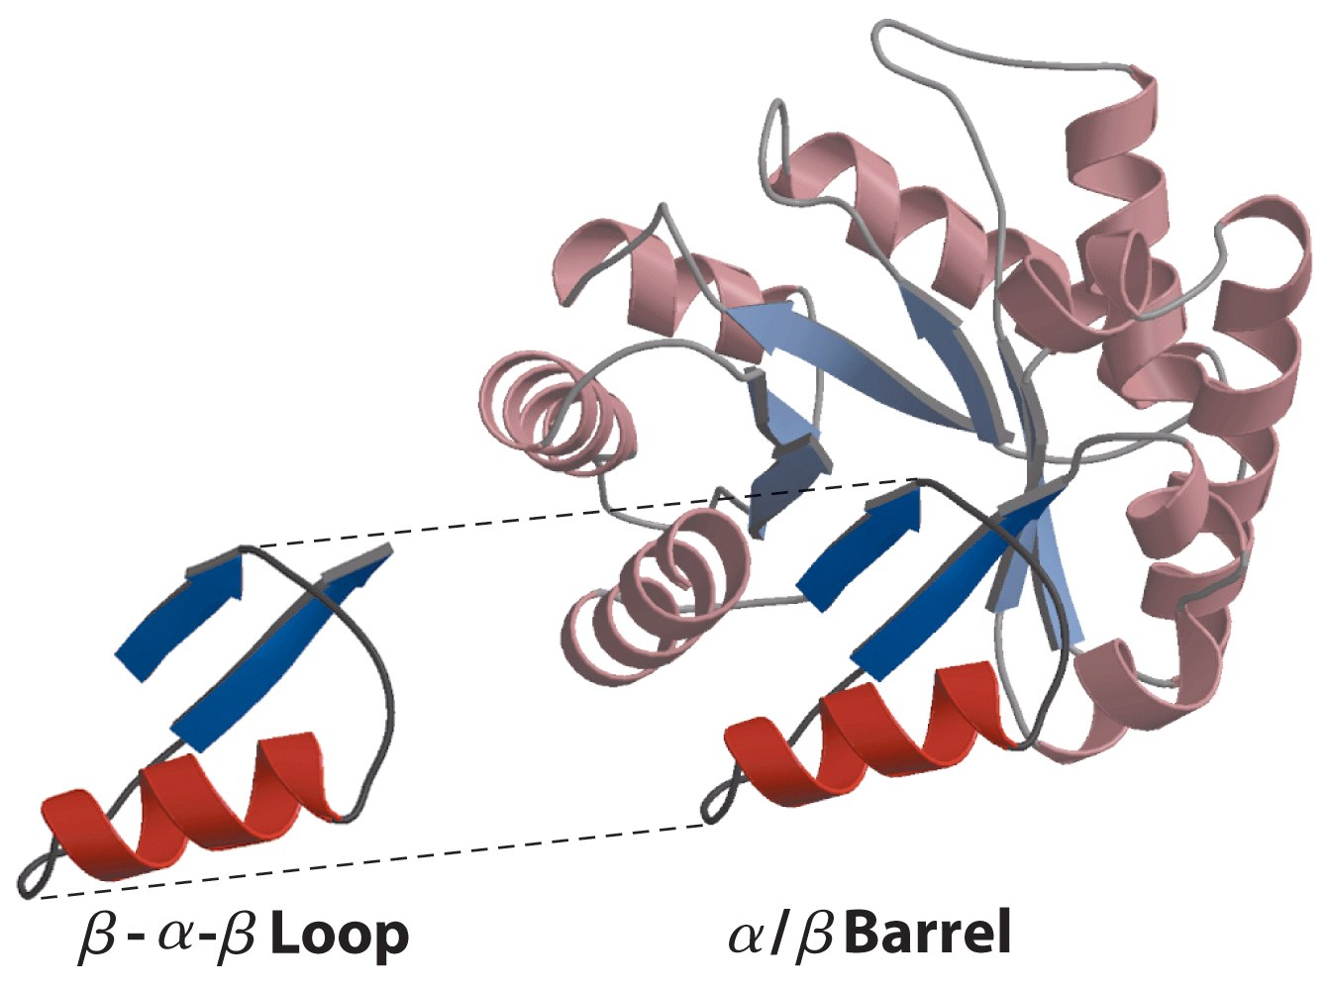
Complex motifs can be built up from simple ones.
βαβ loops (Lehn. 4-21) arrange so that the β strands
form a α/β barrel.

Slide 32
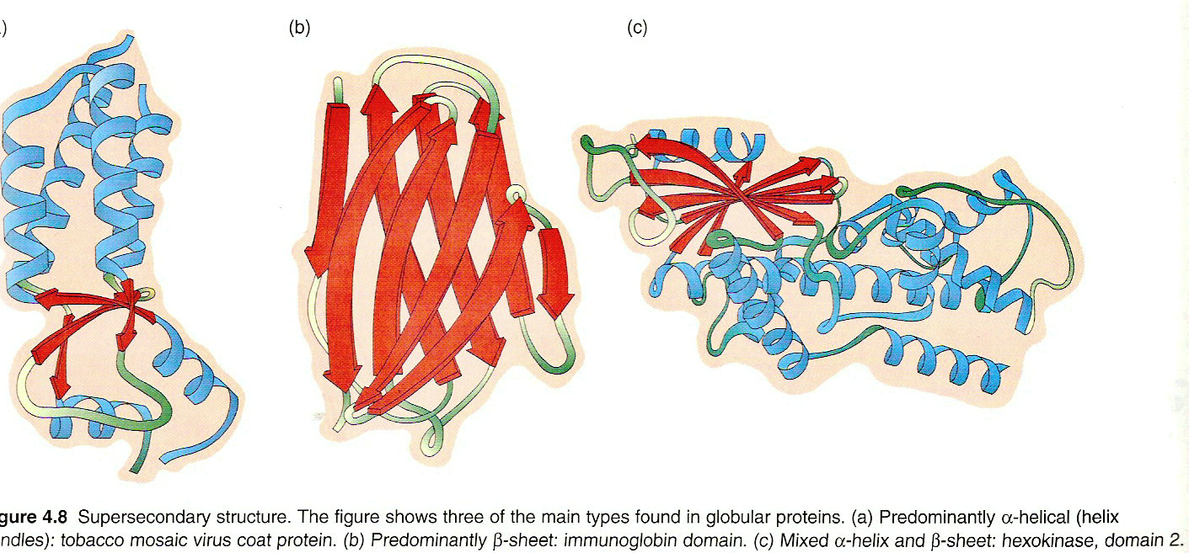
Motifs or Supersecondary structures and tertiary structure. 4 classes of motifs: all α, all β, α/β (alternating) or α+β (segregated). (Dow fig 4.8)

Slide 33
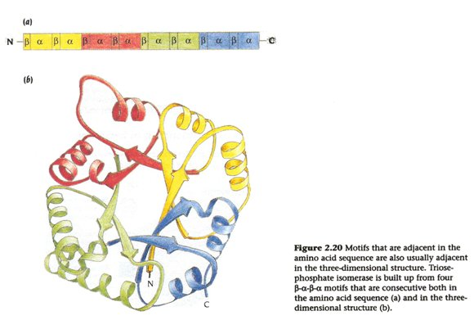
Primary,secondary and tertiary structure (protein folding) of triose phosphate isomerase. Moreover we see here a MOTIF (which class ?).
The motif here is baba.

Slide 34
Domain
A part of a polypeptide chain that is indepently stable or could undergo movements as a single entity with respect to the entire protein.

Slide 35
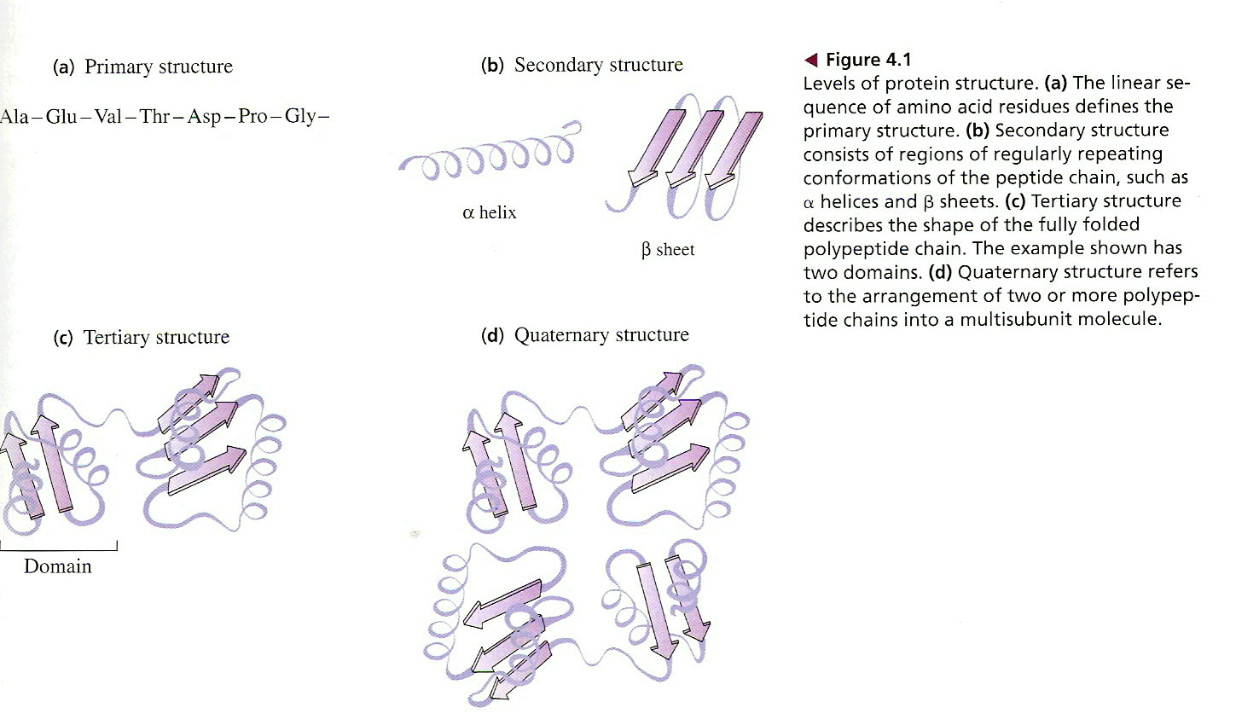
DOMAINS are distinct globular units (independently folded) within one polypeptide. Usually domains are connected by loops. In (c) we see two domains. (Horton fig 4.1)

Slide 36
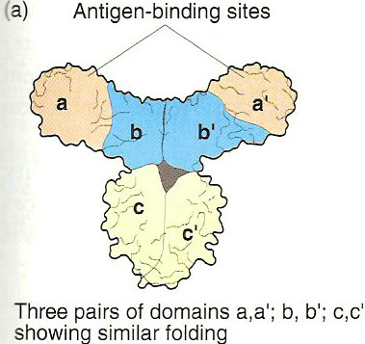
DOMAINS II In this protein we can distinguish three pairs of domains. Proteins can be grouped into families according to similarities in domain structures and amino acid sequence. (Dow fig 4.7)

Slide 37
Domains III: domains are encoded by specific exons. (Campb. fig 17.12)

Slide 38

Lehninger figure 4.19, 4.20 and 4.21; motifs and domains
Two or more α and/or β elements → supersecondary structure (motifs or folds) for instance: the β α β loop is a small motive the α/β barrel is a complex motive
All proteins are assembled from a repertoire of only a few hundred motifs.
A domain is a globular region of a protein that can fold stably and independently. The α/β barrel and the β barrel can be domains.

Slide 39
Tertiaire structuur
Verbindingen tussen restgroepen
Waterstofbruggen
Ionenbinding
Hydrofobe interacties
Apolaire groepen naar kern van het eiwit
Van der Waals kracht
Zwavelbruggen

Slide 40
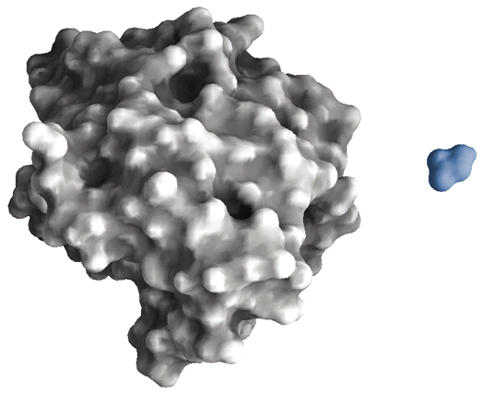
TERTIAIRE structuur = ruimtelijke conformatie = protein folding Drie-dimensionale structuur van het totale proteine. De tertiaire structuur maakt proteinen uiterst compact.
Chymotrypsine (240 residuen) en glycine.
(Lehn. fig 4-1)
Volledig bepaald door de specifieke aminozuurvolgorde (primaire structuur). De tertiaire structuur ligt “besloten” in de primaire structuur.
Notes:
40

Slide 41
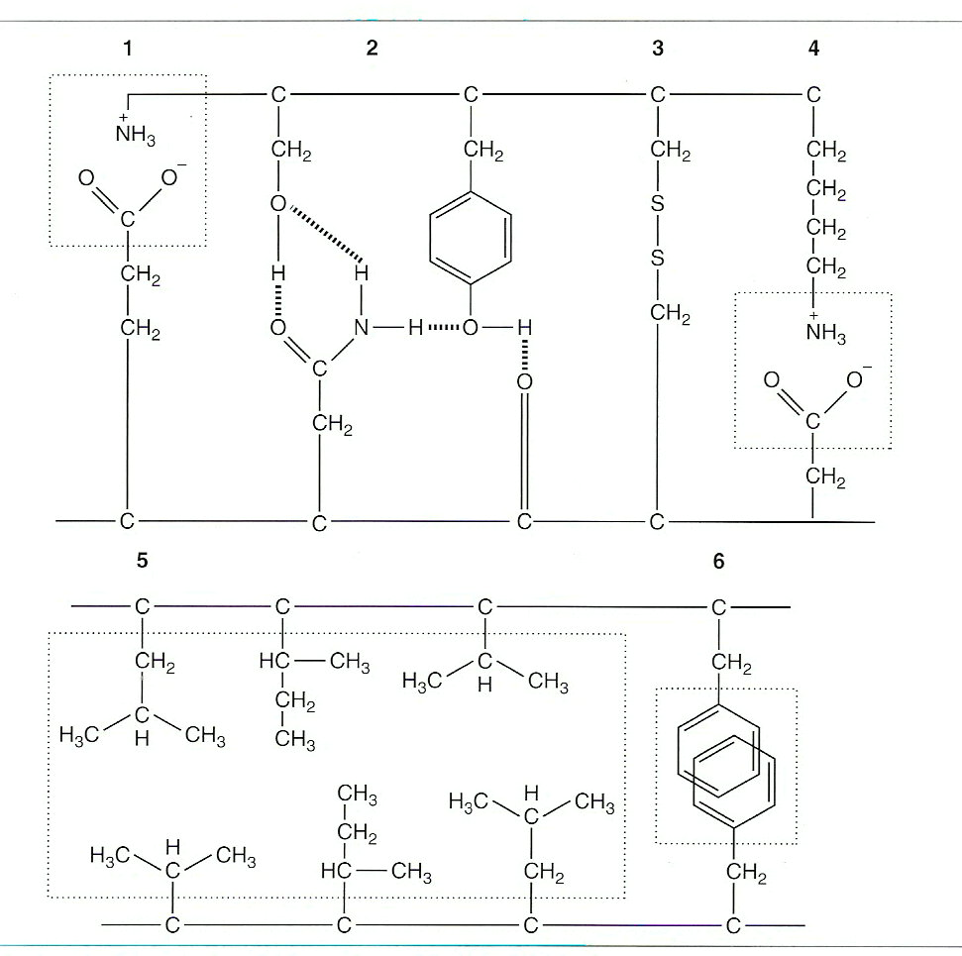
Fig 3-13 FC Schuit, Medische Biochemie

Slide 42
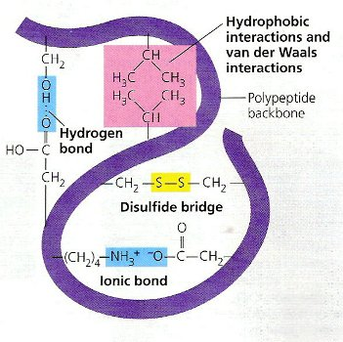
The tertiary structure is marginal stable. (Campb fig 5.21) release of one weak interaction ~ 20 kJ/mol release of one covalent bond ~ 200 kJ/mol (see Lehn figure 4.28)
Disulfide bonds we find
mainly in proteins
to be excreted.
Cytoplasmatic proteins
never have disulfide
bonds.

Slide 43
Some examples of “marginal stable”
FEVER The tertiary structure changes between 36 ⁰ and 42 ⁰ → protein becomes inactive
Cystic Fibrosis wrong folding (wrong tertiary structure) because one amino acid lacks
Sickle cell anemia wrong folding (tertiary and quaternary) because one amino acid changed (glu → val)

Slide 44
Cystic fibrosis; wrong protein folding !
Wrong folding of a Cl⁻ transporting protein in phlegm
(mucus, slime) producing cells.
Normally it transport Cl⁻ together with water.
The effect is the “life threatening” production of
copious phlegm, especially in the lungs.
The cause is a three base deletion in the gene of
the protein; it lacks a phe residue.

Slide 45
Quaternaire structuur
Samenvoegen polypeptideketens

Slide 46
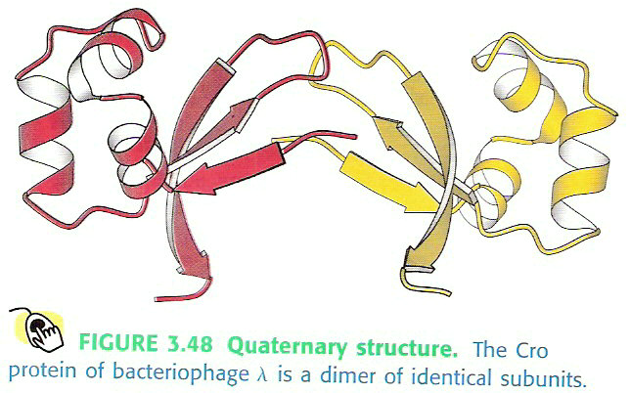
Quaternary structure: the subunits are hold together by non-covalent interactions. (Str fig 3.48)

Slide 47
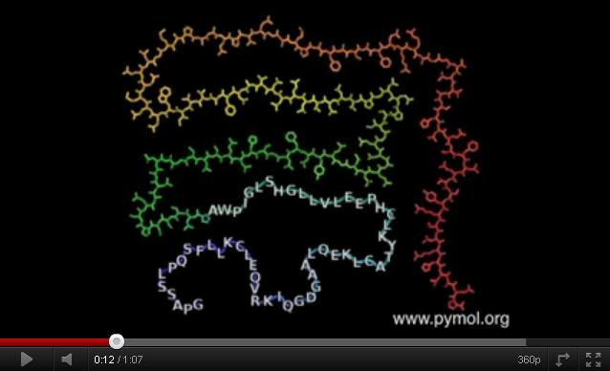

Slide 48
What is denaturation?
Which circumstances cause denaturation?
Examples?

Slide 49
Denaturation of proteins; changing of higher order structure and loss of biological activity. Unfolding → loss of compactness → expansion The protein becomes more or less soluble. Totally or partly unfolding by disrupting of non-covalent interactions (= weak interactions). Denaturation or unfolding has to do with a change in the quaternary, tertiary and secondary structure.

Slide 50
Denaturation can be reversible or irreversible. Heat denaturation in general is irreversible. Denaturation means unfolding ! Denaturation means loss of compactness. (Campb fig 5.23)

Slide 51
Some examples of denaturation
FEVER The tertiary structure changes between 36 ⁰ and 42 ⁰ → protein becomes inactive
Boiling an egg

Slide 52
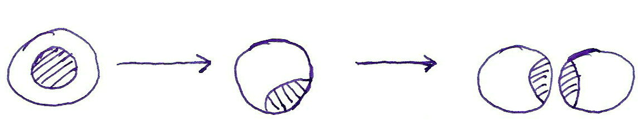
Heating → especially internal H-bonds are disrupted → α helices unfold → parts of the hydrophobic core are exposed to the surface → hydrophobic aggregation / precipitation Heat denaturation is irreversible and makes proteins insoluble !

Slide 53
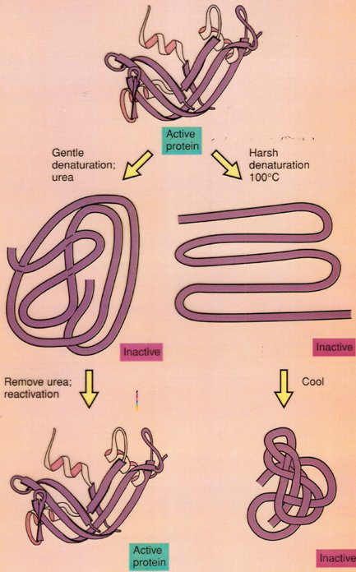
Urea and SDS denaturation increase the solubility of proteins. Hydrophobic interactions in the stable core are disrupted. (Brock fig 3.19)

Slide 54
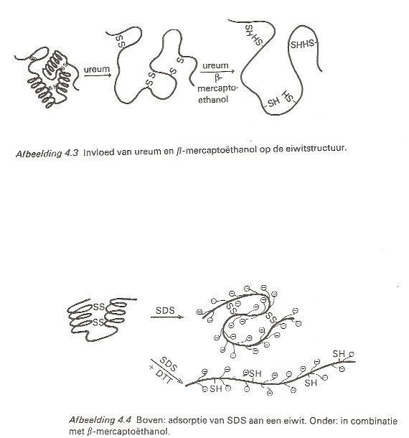
denaturation unfolding expansion loss of compactness Disulfide bonds can be reduced by …. and ….. (Braam fig 4.3 and 4.4)

Slide 55
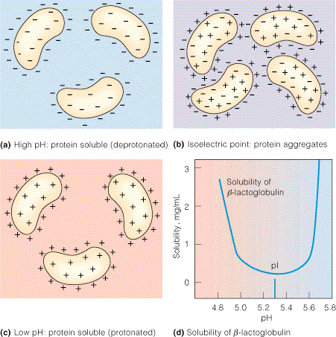
Solubility with pH; at high and low pH proteins expand and denature
Minimum when pH =pI
pI is the pH at which the molecules have zero net charge
Notes:
55
55
When molecules have a net charge they repel and therefore remain in solution. At the pI the net charge is zero and the molecules can clump together.

Slide 56
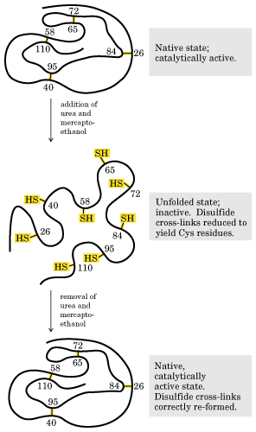
Anfinsen (1950): denaturation by reduction and unfolding of ribonuclease is reversible.
The native folding of a protein is determined by the primary structure.
Folding of proteins is often assisted by chaperonins (protein complexes); see fig 4.29.
(Lehn. fig 4-27)
Notes:
56
56

Slide 57
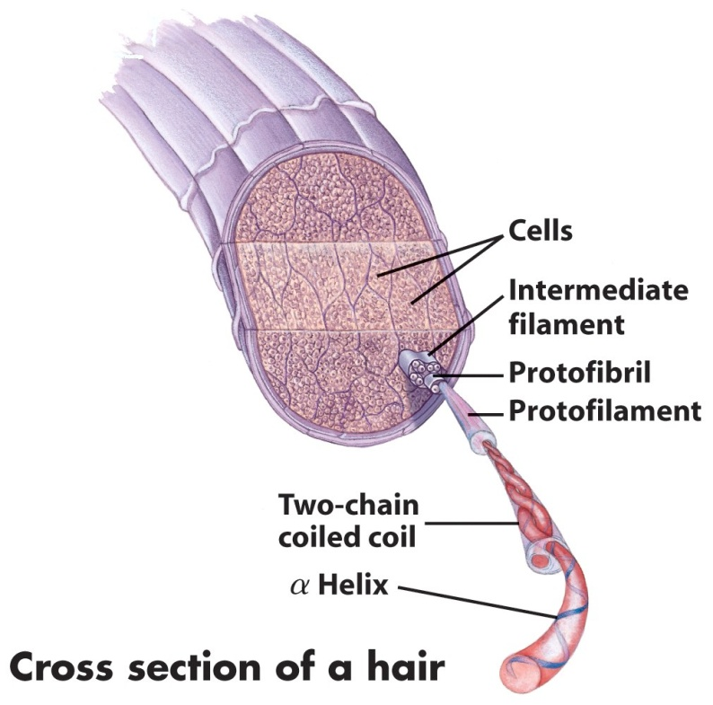
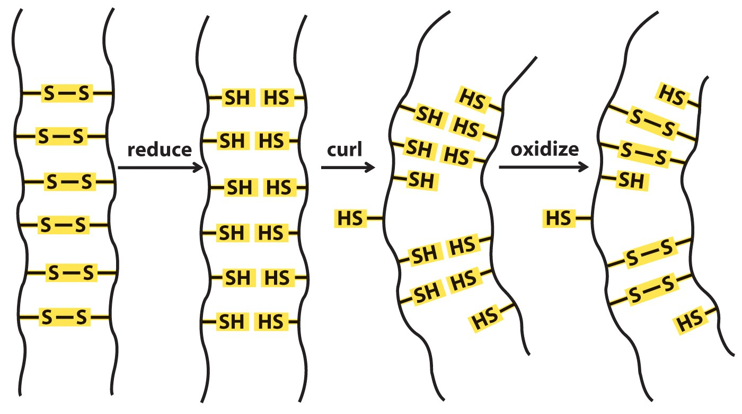
Vochtige warmte: α-keratine in haren gaat van α–helix naar β–sheet conformatie. Reduceren, krullen zetten, oxideren en afkoelen.
(Lehn fig 4-11 and box 4-2)

Slide 58
https://www.youtube.com/watch?v=SMNlfNJKdRc

Slide 59
Where do all these beautiful figures originate from ?
Most figures originate from the book you posses;
Lehninger, Principles of Biochemistry, W.H. Freeman and Company,
4e and 5e: in slides 6 (fig 4.7), 9 (fig 4-8), 10 (fig 4-10), 11 (table 4-2), 19 (fig 4-21),
37 (fig 4-27), 38 (fig 4-11 and Box 4-2)
Horton a.o., Principles of Biochemistry, Prentice Hall (Pearson Education),
3e edition: in slides 28 (table 4.1), 7 (fig 4.16), 15 (fig 4.23), 18 (fig 4.19), 21 (fig 4.1),
Meisenberg a.o., Principles of Medical Biochemistry, Mosby (Elsevier),
2e edition: in slide 36 (fig 2.11).
Campbell a.o., Biology, Pearson International Edition, 8e edition:
in slides 3 (fig 5.21), 8 (fig 5.21), 23 (fig 17.12), 27 (fig 5.21), 32 (fig 5.23),
Stryer and Berg a.o., Biochemistry, W.H. Freeman and Company,
5e edition: in slides 2 (fig 3.30), 20 (fig 3.43 and 3.60), 29 (fig 3.48),

Slide 60
Brock, Biology of Microorganisms, Pearson 11e edition: in slides 4 (fig 3.16),
5 (fig.16), 33 (fig 3.19)
Dow a.o., Biochemistry, Addison-Wesley, 1e edition: in slides 16 (fig 4.8),
22 (fig 4.7)
Braam, Biochemische werkwijzen: in slides 33 (fig 4.3 and 4.4), 34 (fig 5.2 and 5.3),

